Slide 1
Understanding Attrition and Salary
DDSAnalytics
Joseph Lazarus

Slide 2

Executive Summary
DDSAnalytics is looking to gain a competitive edge by providing useful insights into their product.
We will review current trends in the area of employee attrition.
Provide insight into Salary predictions

Slide 3




Agenda
We will cover:
Data Cleaning
Features
Explore the Data
Trends

Slide 4

Data Cleaning
Remove major errors, inconsistencies, outliers, NA’s.
Understanding the data
Over 18
Standard Hours
Employee number

Slide 5
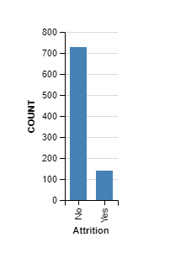
Target Category Identification
Total 870
Attrition No 730
Attrition Yes 140

Slide 6
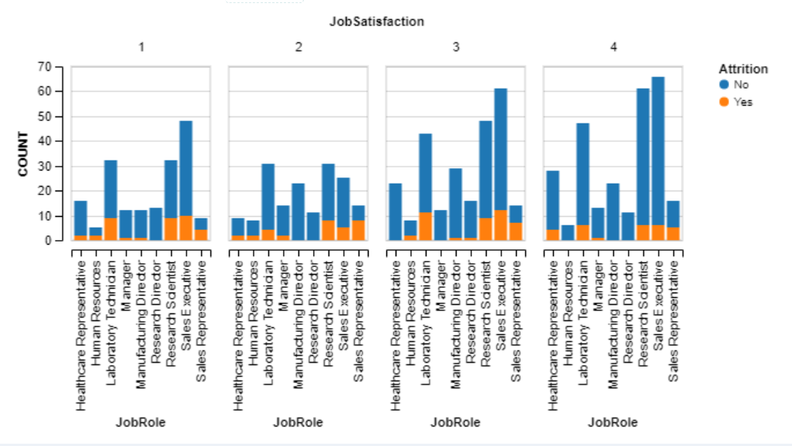
Work Place Satisfaction By Department
Research Scientists and and sales execs had the highest job satisfactions
Research directors report the lowest job satisfaction at around 25% of their population within the company.

Slide 7
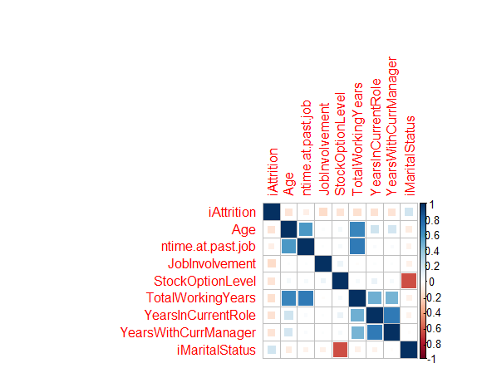
Quantitative Data

Slide 8
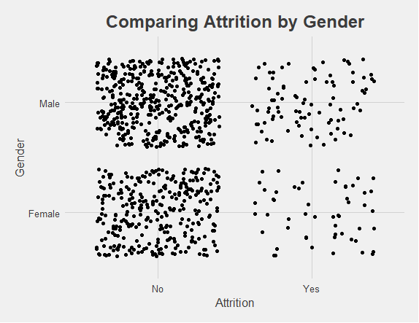
Gender not a Factor
By comparing the scatter plots of Attrition by Gender I could eliminate Gender as a factor.

Slide 9
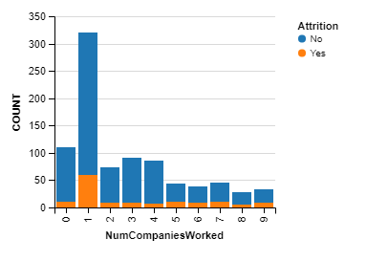
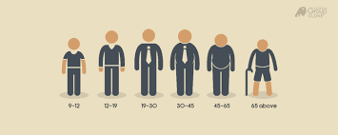


Feature Engineering
Simplify Ages into Groups
Create income Brackets
Length of time at company (loyalty)

Slide 10

Classification Terms
Precision: The rate at which positive predictions are made. Is good when the cost of a False Positive is high
True positives
True positives + False Positives

Slide 11

Classification Terms
Sensitivity: The rate at which positive predictions are made ~ True Positive Rate ~ Of all the people in attrition category how many did we predict?
True positives
True positives + False Negative
Note: Sometimes referred to as “Recall”

Slide 12

Classification Terms
Specificity: rate of actual negative cases predicted as negative ~ True Negative Rate
True Negatives
True Negative + False Positives

Slide 13

Classification Terms
Accuracy: total number of correct classifications.
True Positives +True Negatives
Total
Note: Total = (tp + tn +fp +fn)

Slide 14
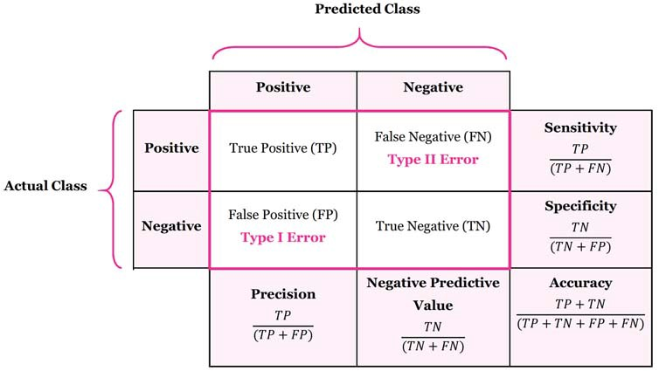
Putting It All Together
The Confusion Matrix

Slide 15
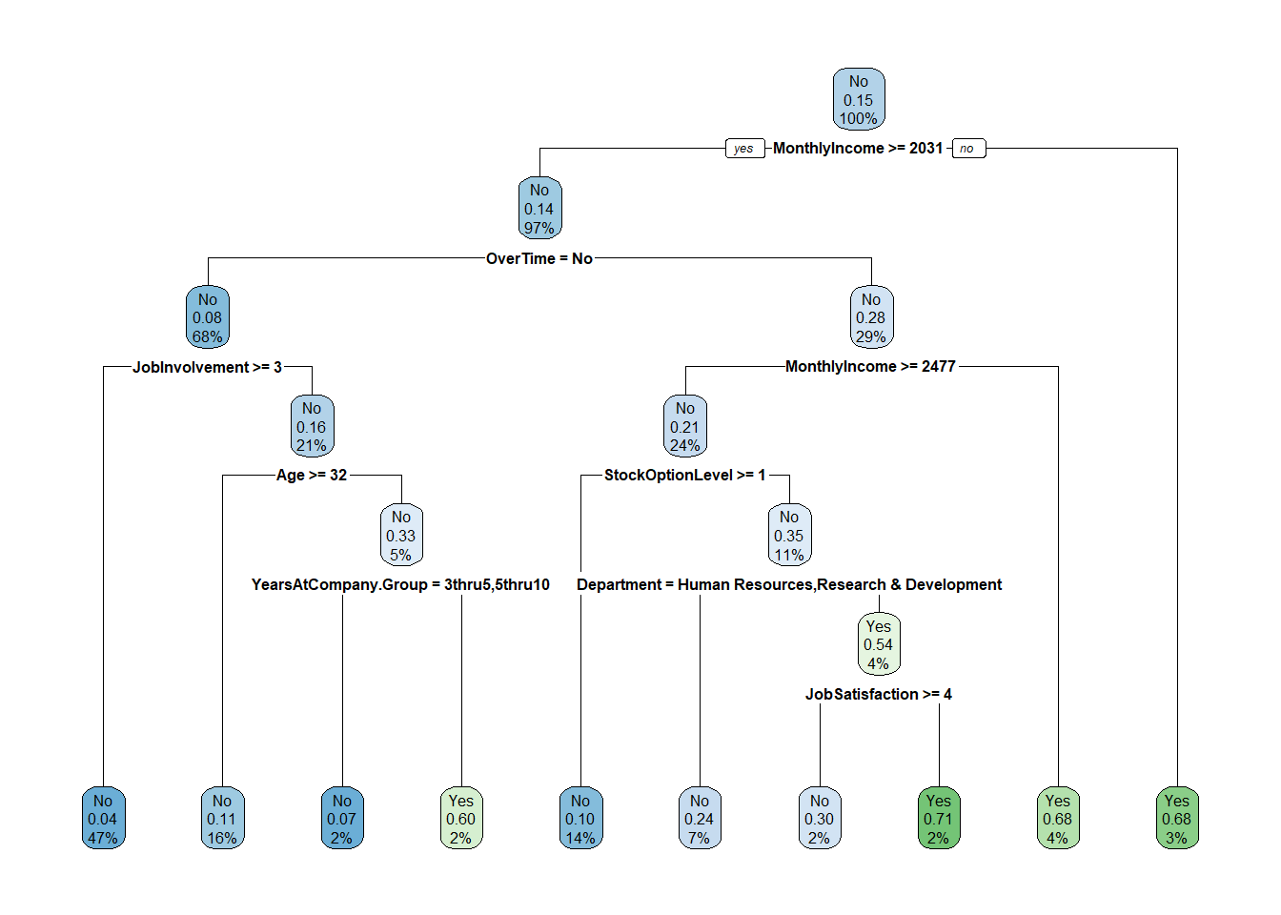
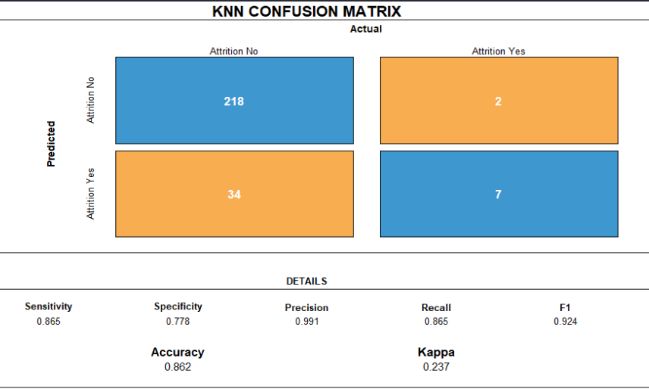
Models Used
KNN
Decision Tree Model

Slide 16
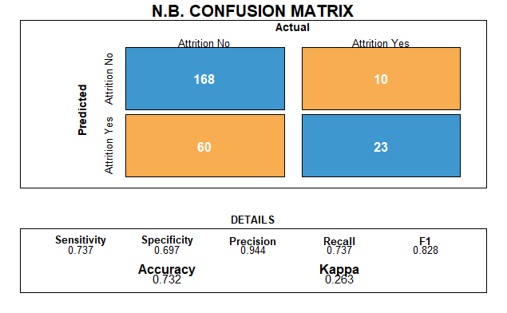
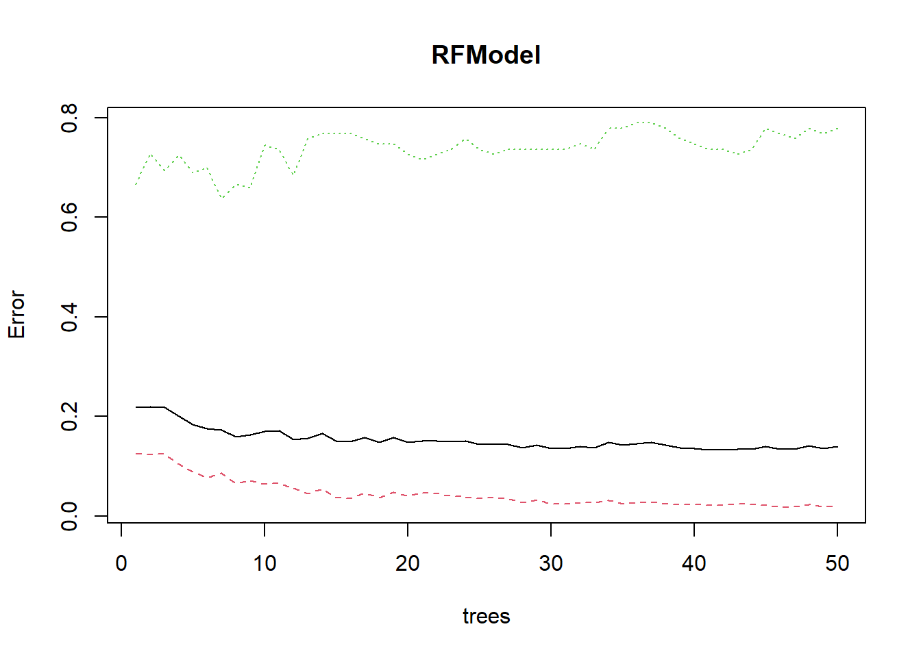
Models Used
Naïve Bayes
Random Forest

Slide 17

Comparing the Models

Slide 18
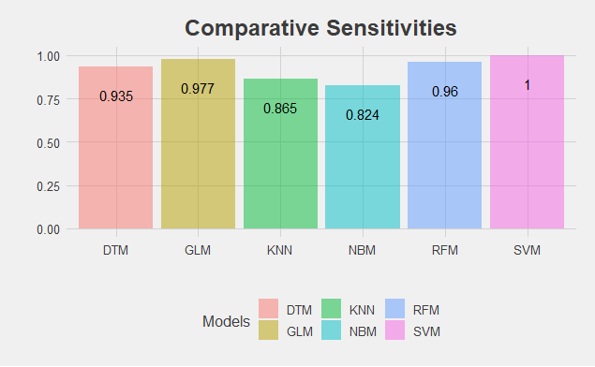
Sensitivities ~ True Positive Rate

Slide 19
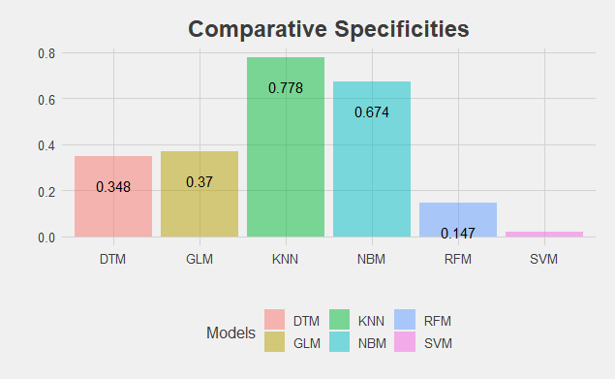
Specificities ~ True Negative Rate

Slide 20
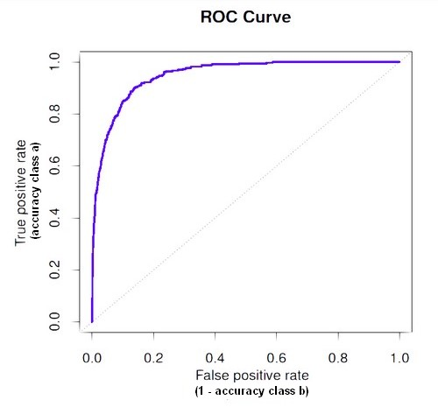
Top Three Factors ROC curve and AUC
Variable | Area Under the Curve
MonthlyIncome | 0.683
TotalWorkingYears | 0.662
OverTime | 0.662
StockOptionLevel | 0.662
YearsAtCompany | 0.651
JobLevel | 0.655
Notes:
AUC stands for Area Under the Curve. ROC can be quantified using AUC. The way it is done is to see how much area has been covered by the ROC curve. If we obtain a perfect classifier, then the AUC score is 1.0. If the classifier is random in its guesses, then the AUC score is 0.5. In the real world, we don’t expect an AUC score of 1.0, but if the AUC score for the classifier is in the range of 0.6 to 0.9, then it is considered to be a good classifier.

Slide 21

Monthly Income : Predicting Salary Trends

Slide 22
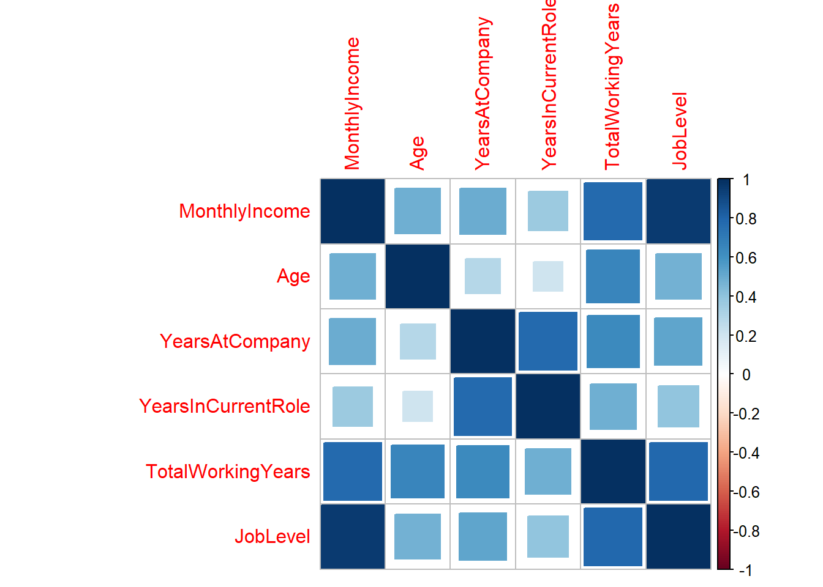
EDA of Salary
Started by looking doing a correlation plot on quotative variables

Slide 23
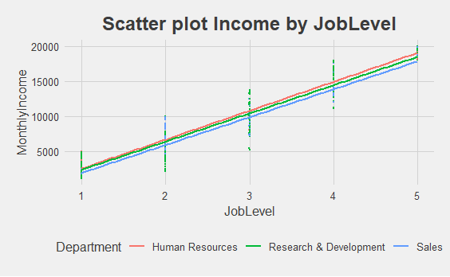
Scatter Plot Income by Department and level

Slide 24
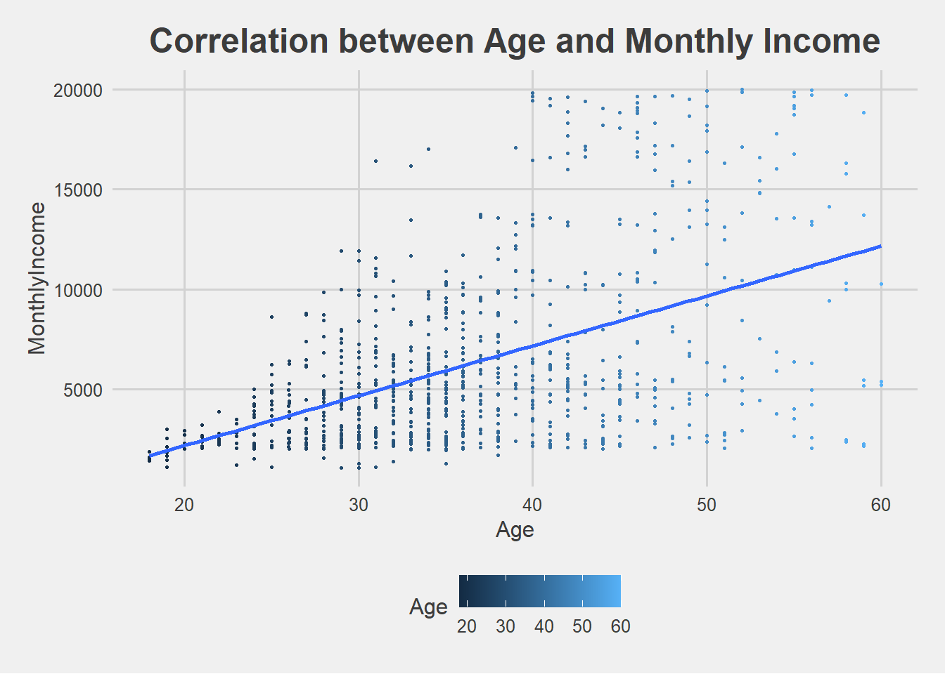
Regression Fits

Slide 25
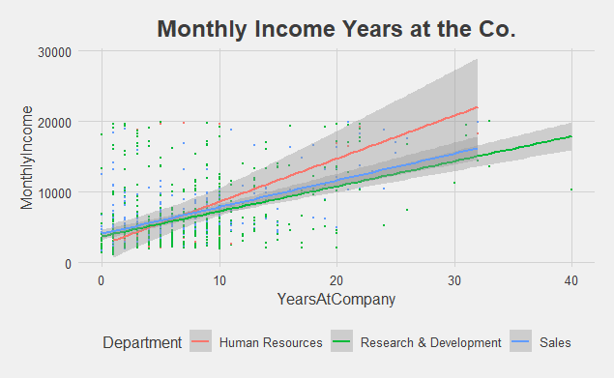
Regression Fits

Slide 26
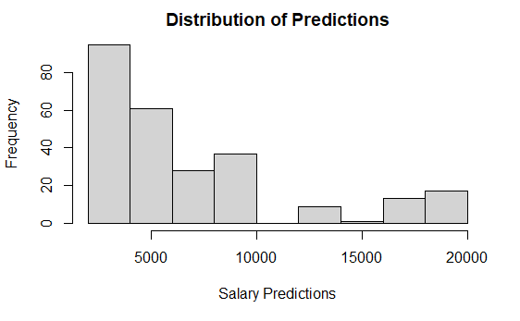
Model Performance and Variable Importance
Variable | Area Under The Curve
β₀ | 528.68
β_{x} (job level) | 2712.27
β_{x2}Total Working Years | 53.51
RMSE | R² | MAE
1022.88 | 0.958 | 804.23

Slide 27
Conclusion Key Issues
EDA
Identify key decisions about feature engineering
KNN and Naïve Bayes outperformed the other Models for Classification
Takeaways
Stock Options might be a feature the company could use to decrease attrition
Younger employees tend to switch jobs more often. No difference was detected based on gender
Monthly Income is highly correlated with Job level.

